Slide 1
Criminal Face Identification System
Final Year Project Presentation
2019-2020
Information Technology
Institute Of Engineering And Technology, Lucknow
Presented by :
| Anjani Kumar Mall | Rahul Majhi | Sunil Kumar Bajpai
| 1705213901 | 1705213908 | 1705213911
Supervisor :
Ms. Deepa Verma

Slide 2
Contents
Why this system is required?
Introduction
Objective
H/W and S/W requirement
Methodology
Process
Results
Conclusion

Slide 3
Why This System Is Required
Since, criminal have tendency to involve in various and repeated crimes.
Using technology, to track history sheeters or identify wanted person in real time.
Manual surveillance operations are very tedious and chances of human error is high.

Slide 4
Introduction
Criminal face identification system is based on face identification technology. Since, face is primary focus of attention in social intercourse.
This system aims to track habitual criminal those are registered with the system.
This system is built on python using Open-CV and face-recognition library.

Slide 5
Objective
This following system is use to facilitate the law enforcement official by the following
Registering criminal
Photo matching
Custom Video surveillance

Slide 6
Hardware and Software requirement
Hardware:
4 GB RAM (Minimum)
80 GB HDD.
Dual Core processor.
VGA resolution monitor.
Camera (webcam/CCTV)
Software:
Microsoft Windows 7 or higher
Python 3.5+
OPEN-CV 4.4.0.40
Face_recognition
SQLite Studio
Notepad

Slide 7
Methodology

Slide 8
Haar Cascade
This is machine learning object detection algorithm used to identify object in image and video.
A simple rectangular Haar-like feature can be defined as the difference of the sum of pixels of areas inside the rectangle, which can be at any position and scale within the original image. This modified feature set is called 2-rectangle feature.
Faces are scanned and search for haar features of current stage.
The weight and the size of each feature themselves are generated using machine learning algorithm AdaBoost.

Slide 9
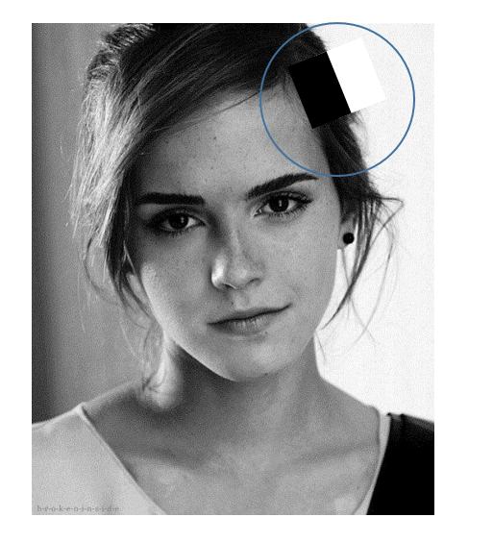
Haar Cascade [cont.]
Haar Features

Slide 10
Haar Cascade
To identify object in a image or video Haar cascade use the following.
1.Haar feature
2.Integral image
3.Adaboost
4.Cascading.

Slide 11
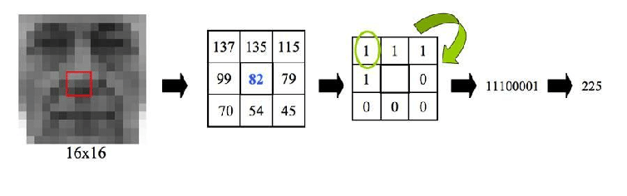
Local Binary Pattern Based Histogram
The LBP operator is applied to describe the contrast information of a pixel to its neighborhood pixels. The original LBP operator is defined in the window of 3*3. Using the median pixel value as the threshold of the window
It compares with the gray value of the adjacent 8 pixels . If the neighborhood pixel value is larger or equal compare to the median pixel value, the value of pixel position is marked as 1, otherwise marked as 0.
N(x) ={ 1, 𝑥 ≥ 0 | 0, 𝑥 < 0 }

Slide 12
Face recognition library
Built using dlib’s state of the art face recognition built with deep learning.
The model has an accuracy of 99% on labeled face in wild benchmark.
This also provides a simple command line tool that lets you do face recognition on a folder of image from command line.

Slide 13
Process

Slide 14
Import the required modules
The Modules required to perform the facial recognition are cv2, os, face-recognition, image module and numpy.
cv2 is the OpenCV module and contains the functions for face detection and recognition.
First, we use this module to extract the image names in the database directory and then from these names individual number is extracted, which is used as a label for the face in that image.
Image module from PIL is used to read the image in grayscale format.

Slide 15
Load the face detection Cascade
To Load the face detection cascade the first step is to detect the face in each image.
For the purpose of face detection, we will use the Haar Cascade provided by OpenCV.
The Haar cascades that come with OpenCV are located in the directory of OpenCV installation.
haarcascade frontalface default.xml is used for detecting the face.
Cascade is loaded using the cv2 CascadeClassifier function which takes the path to the cascade .yml file

Slide 16
Create the Face Recognizer Object
The next step involves creating the face recognizer object.
The face recognizer object has functions like FaceRecognizer.train() to train the recognizer and FaceRecognizer.predict() to recognize a face.
OpenCV currently provides Eigenface Recognizer, Fisherface Recognizer and Local Binary Patterns Histograms(LBPH) Face Recognizer.
LBPH focus on extracting local features from images.
The basic idea of Local Binary Patterns is to summarize the local structure in an image by comparing each pixel with its neighbourhood. LBP operator is robust against monotonic gray scale transformations.

Slide 17
Perform the training
To create the function to prepare the training set, we will define a function that takes the absolute path to the image database as input argument and returns tuple of 2 list, one containing the detected faces and the other containing the corresponding label for that face.
For example, if the ith index in the list of faces represents the 4th individual in the database, then the corresponding ith location in the list of labels has value equal to 4.
Train function requires 2 arguments, the features which in this case are the images of faces and the corresponding labels assigned to these faces which in this case are the individual number that we extracted from the image names.

Slide 18
Perform Testing
For testing the Face Recognizer, we check if the recognition was correct by seeing the predicted label when we bring the trained face in front of camera.
The label is extracted using the os module and the string operations from the name of the sample images folder.
Lower is the confidence score better is the prediction.

Slide 19
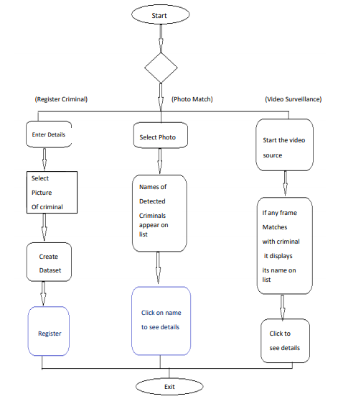
Process flow diagram of CFIS

Slide 20
Results

Slide 21
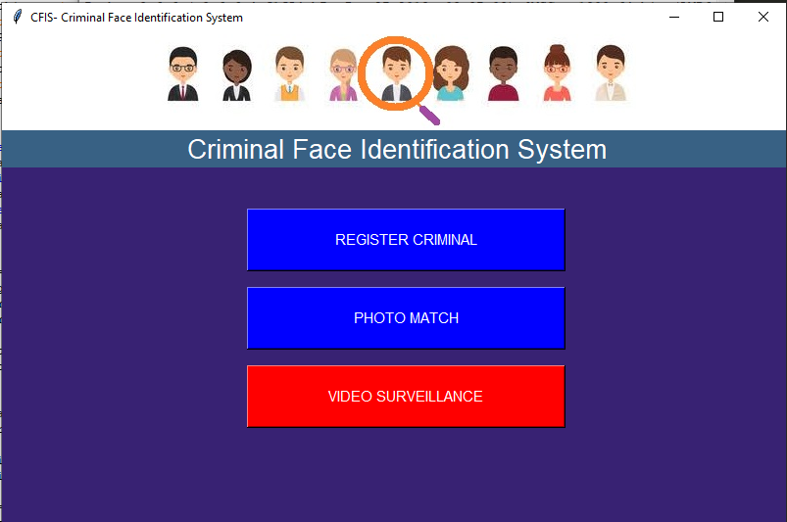
Home Page

Slide 22
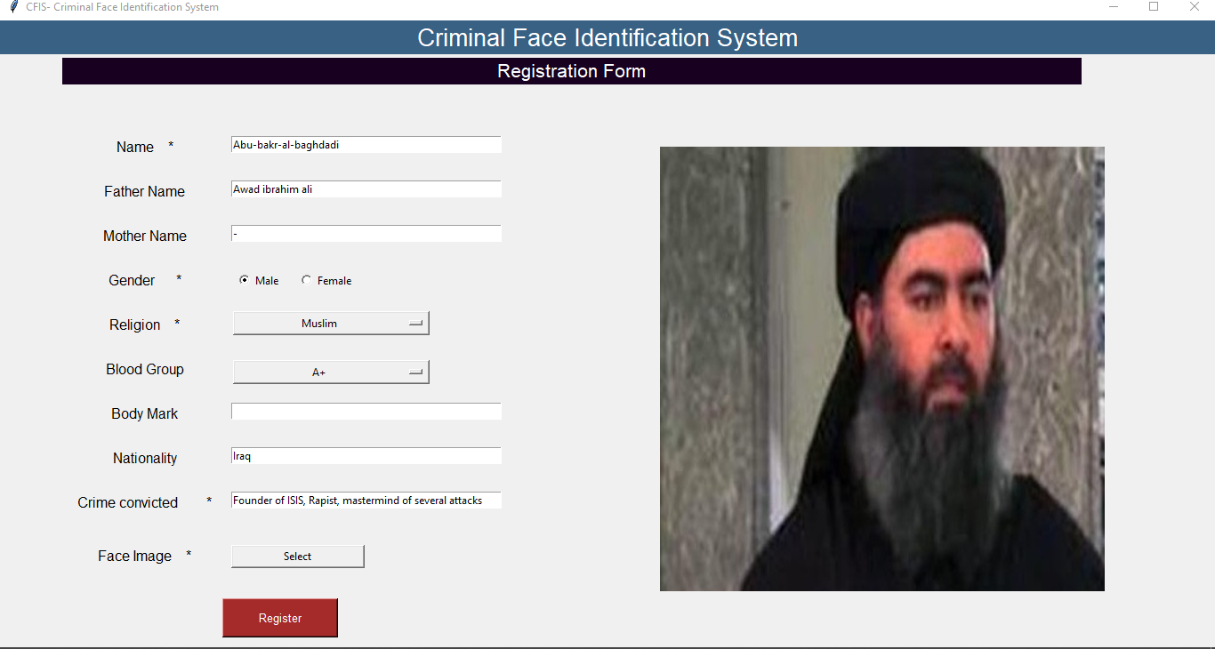
Register Criminal

Slide 23
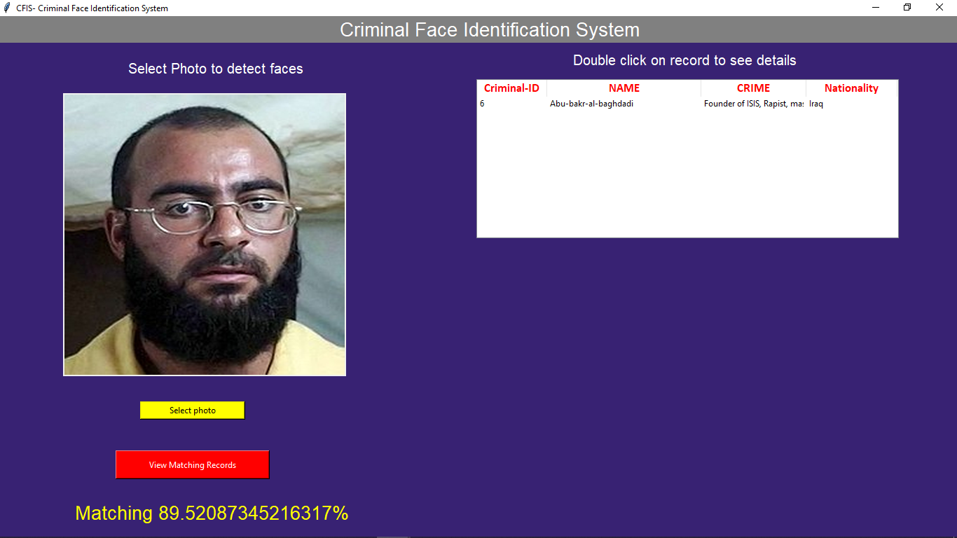
Face identification using Photo Match

Slide 24
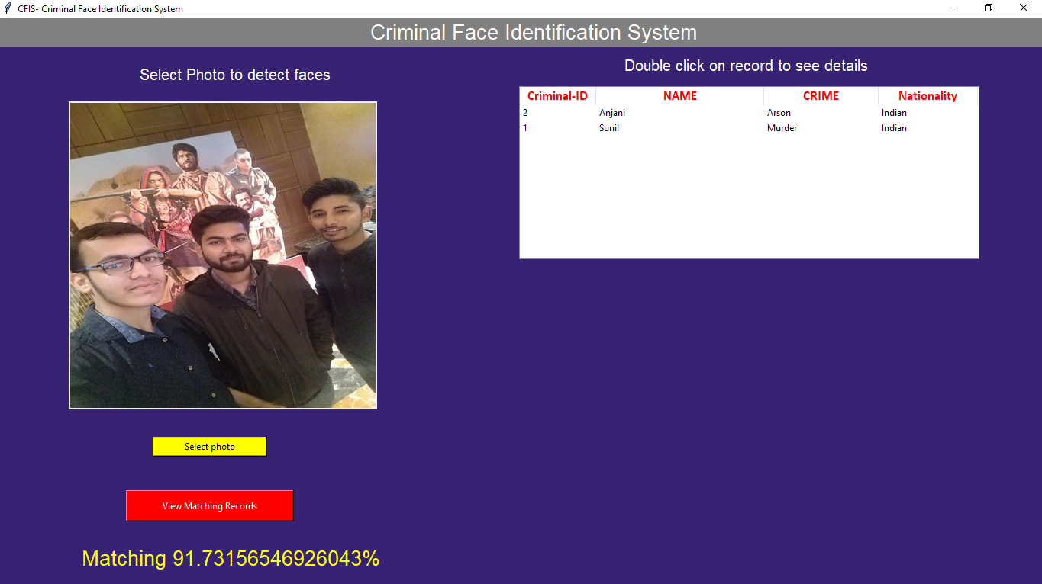
Multiple face detection using Photo Match

Slide 25
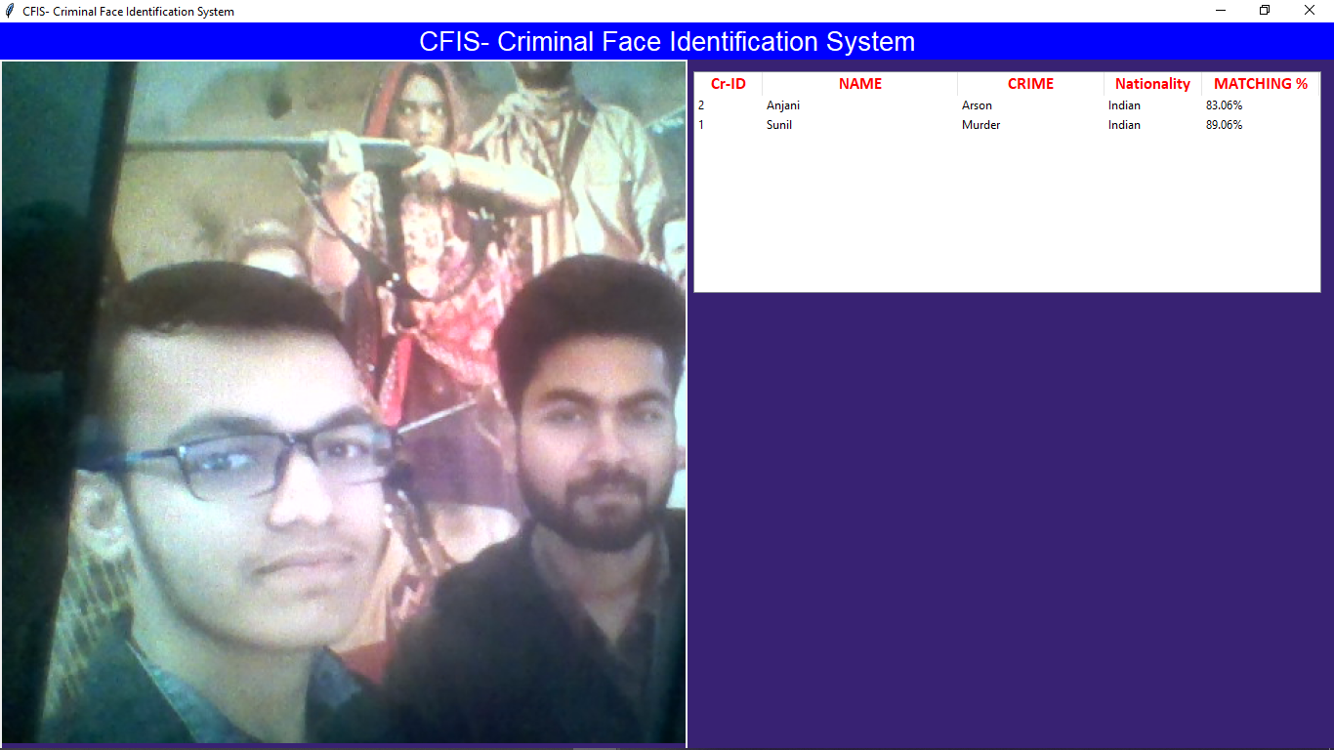
Multiple face detection in Video surveillance

Slide 26

Details of criminal can be viewed from both Photo match and video surveillance

Slide 27
Conclusion
We have used Haar feature-based cascade classifiers in OpenCV approach for face detection. It is a machine learning based approach where a cascade function is trained from a lot of positive and negative images. And we have used Local Binary Patterns Histograms (LBPH) for face recognition. Also in this project we have used face recognition library build with deep learning having accuracy of more than 90%.
In this project, we are able to detect and recognize faces of the criminals in an image and in a video stream. And expecting the proper working of project in real environment.

Slide 28
Future work
Light normalization may allow the threshold value to increase.
Future work may include improvement of face recognition using specific character in the face (distance between eyes) and also analyze the face in 3D by using more than one camera. Using these two method the probability of error will decrease and system will be more accurate.

Slide 29
Thank You!

